Slide 1
THE RISKS AND DANGERS OF VIDEOGAMES
Davide Emanuel
E.Agnelli
5 info

Slide 2
Index
Why people like video games?
Why young people play with videogames?
What are the risks of playing videogames?
How to reduce them
1

Slide 3

Why people like videogames?
The game allows you to enter an alternative world, often more fantastic or captivating than your own, with new rules and often without the limitations that you may encounter in real life.
2

Slide 4
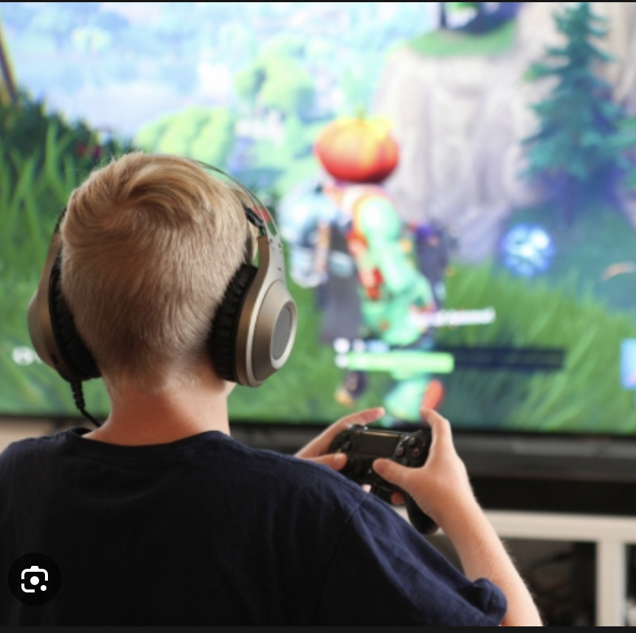
Why young people play with videogames?
When kids play video games there is a significant increase in dopamine. It is a neurotransmitter linked to pleasure and the search for intense emotions. In short, kids experience exciting adventures in video games that they don't find in the real world.
3

Slide 5
What are the risk of playing videogames?
Let's see the main risks that you can run by playing video games too much:
1)Muscle problems: the majority of video games are still played sitting in front of a screen, often with bad posture. This can lead to great muscle stiffness in the long run
2) Epileptic seizures: Some studies suggest an association between the use of video games and epilepsy. For example, according to an article published in the Journal of Neurology, Neurosurgery and Psychiatry, approximately 29% of patients with epilepsy had seizures induced by video games
4

Slide 6

What are the risk of playing videogames?
3) Attention and executive function problems: Recent research has linked the use of video games with greater problems in attention and some related.In particular, some studies have shown that children and adolescent gamers risk having more attentional problems
4) Aggressive behavior: Most of the research on the negative effects of video games has investigated the effects of video games on aggression.
For example, video games can increase aggressive thoughts, emotions and behaviors, both immediately and in the long term or even desensitize players to violence
5

Slide 7

How to reduce them?
be alert, and not remain passive or indifferent, when faced with the first signs of addiction in children. Play with them, choose the video game with them and share with them the necessary and sufficient time to have the pleasure of enjoying this form of entertainment. Do not use them in bedrooms, in this case enemies of precious sleep. And first of all propose some alternatives for example a film, a walk, a reading.
6

Slide 8

Extra slide:what is my personal opinion?
as for myself, I am a very sociable person who lives being with people and who hates being alone for too long without my friends and my non-virtual experiences I would have nothing to tell
(This is one of the many photos that i have with my friends I'm always happy to be with them)

Slide 9
THANKS FOR YOURS ATTENTION! Have a nice day!

